Slide 1
Spring 2021
DATS 501 Fundamentals of Data Science
Cumhur Baştürk
basturkc.academic@gmail.com
Hasan Demirtaş
hasan.demirtas@yeditepe.edu.tr
hdemirtas.academic@gmail.com

Slide 2

Unsupervised Learning
Notes:
Some notes and images were retrieved from slayts of Yücel Saygin and article of Cory Maklin

Slide 3
UNSUPERVISED LEARNING
Let’s say we have customers data which consists of:
age
location
financial history
Question is: you wish to discover patterns from the data...
Or
Let’s say you have a set of texts: (e.g wikipedia pages)
Aim is: to segment them into categories based on their content...
Or
Google News, which automatically groups similar news articles under a topic. How does this happen?
All these are the part of the world of unsupervised learning, called as such because you are not guiding, or supervising, the pattern discovery by some prediction task, but instead uncovering hidden structure from unlabeled data.
Notes:
Some notes and images were retrieved from slayts of Yücel Saygin and article of Cory Maklin

Slide 4
UNSUPERVISED LEARNING
Unsupervised Learning
Clustering
Association
Agglomerative
Hierarchical
Divisive
Partitional
Categorical
Sampling
Large DB
Compression
Notes:
Some notes and images were retrieved from slayts of Yücel Saygin and article of Cory Maklin

Slide 5
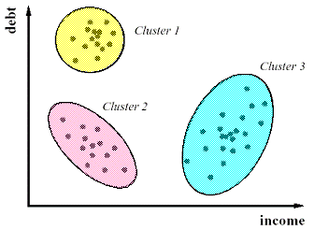
UNSUPERVISED LEARNING
Clustering
A descriptive data mining method.
Groups a given dataset into smaller clusters, where the data inside the clusters are similar to each other while the data belonging to different clusters are dissimilar.
Similar to classification in a sense but this time we do not know the labels of clusters. Therefore it is an unsupervised method.
Notes:
Some notes and images were retrieved from slayts of Yücel Saygin and article of Cory Maklin

Slide 6
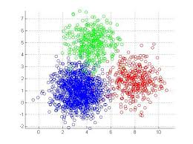
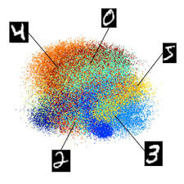
UNSUPERVISED LEARNING
What Is Good Clustering?
A good clustering method will produce high quality clusters with
high intra-class similarity
low inter-class similarity
The quality of a clustering result depends on both the similarity/distance measure used by the method and its implementation.
The quality of a clustering method is also measured by its ability to discover some or all of the hidden patterns.
Notes:
Some notes and images were retrieved from slayts of Yücel Saygin and article of Cory Maklin

Slide 7
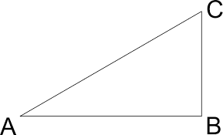
UNSUPERVISED LEARNING
How to measure for clustering?
Dissimilarity/Similarity Between Objects: Similarity is expressed in terms of a distance function:
d(i, j)
Properties of a distance function
d(i,j) ≥ 0
d(i,i) = 0
d(i,j) = d(j,i)
d(i,j) ≤ d(i,k) + d(k,j)
We do use Lk norm functions, e.g Euclidian distance, Manhattan distance, ...
Notes:
Some notes and images were retrieved from slayts of Yücel Saygin and article of Cory Maklin

Slide 8
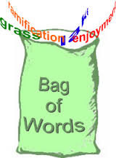
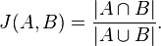

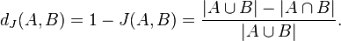
UNSUPERVISED LEARNING
Similarity Between Sets
Sets can be represented as a vectors of binary variables.
Documents can be represented as a set of words
Jaccard Similarity between sets (A similarity measure that does not count matching zero entries)
Jaccard Distance between sets
In Other Words:
(# of variables with matching NONzero value for observations u and v)
(total # of variables) - (# of variables with matching zero value for observations u and v)
Notes:
Some notes and images were retrieved from slayts of Yücel Saygin and article of Cory Maklin

Slide 9
UNSUPERVISED LEARNING
Major Clustering Approaches
Partitioning algorithms: Construct various partitions and then evaluate them by some criterion.
Hierarchical algorithms: Create a hierarchical decomposition of the set of data (or objects) using some criterion.
Density-based: based on connectivity and density functions
Notes:
Some notes and images were retrieved from slayts of Yücel Saygin and article of Cory Maklin

Slide 10
Partitioning Algorithms
Notes:
Some notes and images were retrieved from slayts of Yücel Saygin and article of Cory Maklin

Slide 11
UNSUPERVISED LEARNING
Partitioning Algorithms: Basic Concept
Partitioning method: Construct a partition of a database D of n objects into a set of k clusters
Given a k, find a partition of k clusters that optimizes the chosen partitioning criterion
Heuristic methods: k-means and k-medoids algorithms
k-means (MacQueen’67): Each cluster is represented by the center of the cluster
k-medoids or PAM (Partition around medoids) (Kaufman & Rousseeuw’87): Each cluster is represented by one of the objects in the cluster
Notes:
Some notes and images were retrieved from slayts of Yücel Saygin and article of Cory Maklin

Slide 12
UNSUPERVISED LEARNING
The K-Means Clustering Method
Given k, the k-means algorithm is implemented in four steps:
Partition objects into k nonempty subsets
Compute seed points as the centroids of the clusters of the current partition (the centroid is the center, i.e., mean point, of the cluster)
Assign each object to the cluster with the nearest seed point
Go back to Step 2, stop when no more new assignment
Notes:
Some notes and images were retrieved from slayts of Yücel Saygin and article of Cory Maklin

Slide 13
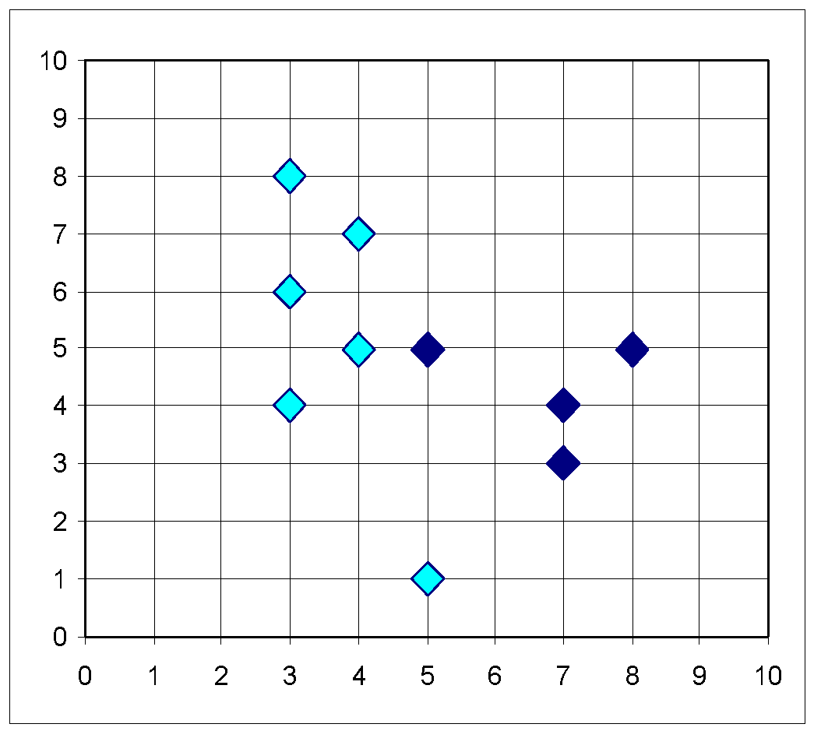
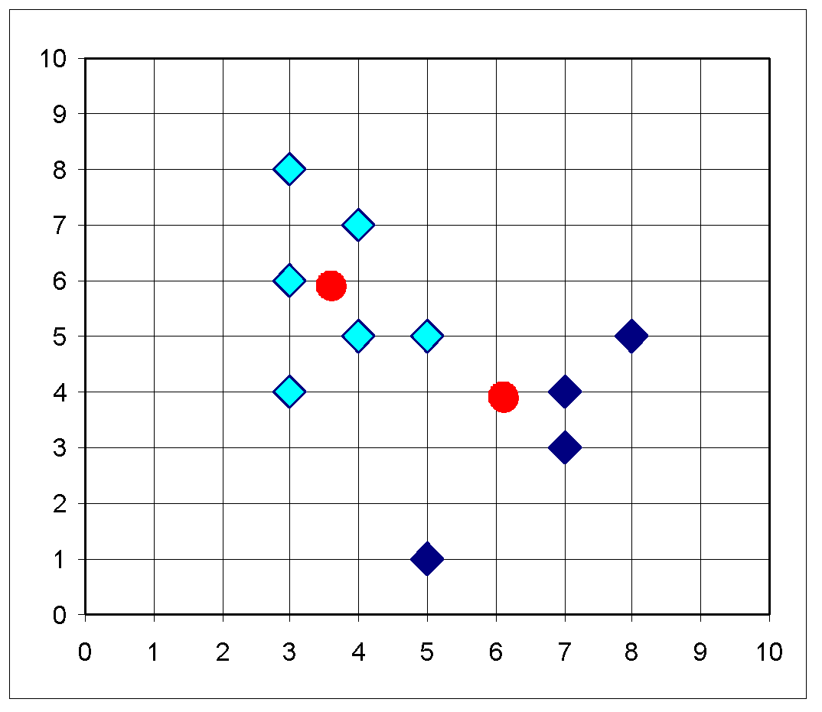
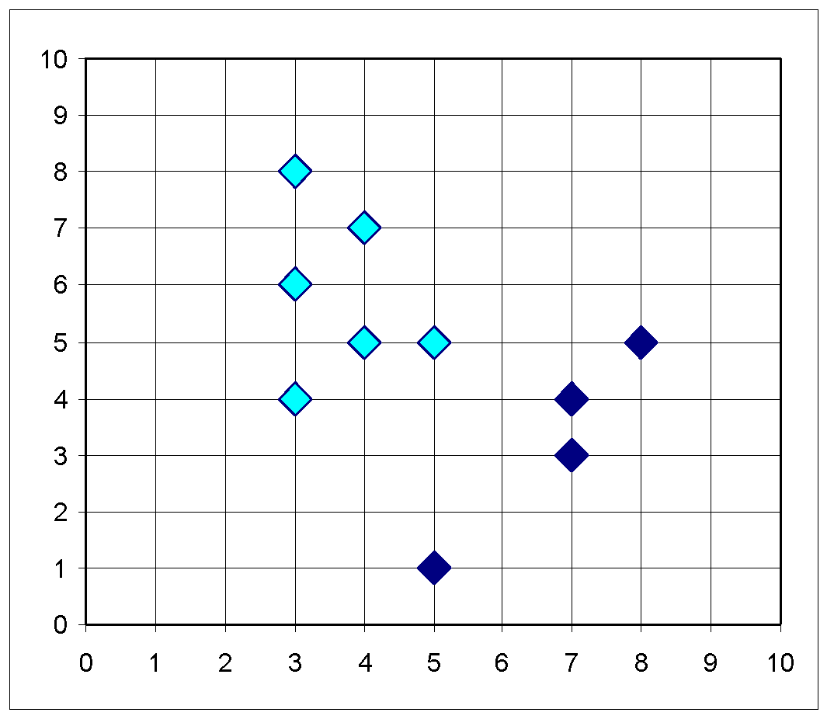
UNSUPERVISED LEARNING
Example
10
10
9
9
8
8
7
7
6
6
5
Update the cluster means
5
4
Assign each objects to most similar center
4
3
3
2
2
1
1
0
0
1
2
3
4
5
6
7
8
9
10
0
0
1
2
3
4
5
6
7
8
9
10
reassign
reassign
K=2
Arbitrarily choose K object as initial cluster center
Update the cluster means
Notes:
Some notes and images were retrieved from slayts of Yücel Saygin and article of Cory Maklin

Slide 14
UNSUPERVISED LEARNING
Data Points: [2, 3, 4, 10, 12, 20, 30, 11, 25]
Arbitrarily given "mean" points: [3,4]
k: 2
 | Round-1 |  |  | Round-2 |  |  | Round-3 |  |  | Round-4 |  |  | Round-5
Means | 3 | 4 |  | 2.5 | 16 |  | 3 | 18 |  | 4.75 | 19.6 |  | 7 | 25
Points | 2 | 4 |  | 2 | 10 |  | 2 | 12 |  | 2 | 20 |  | 2 | 20
 | 3 | 10 |  | 3 | 12 |  | 3 | 20 |  | 3 | 30 |  | 3 | 30
 |  | 12 |  | 4 | 20 |  | 4 | 30 |  | 4 | 25 |  | 4 | 25
 |  | 20 |  |  | 30 |  | 10 | 11 |  | 10 |  |  | 10
 |  | 30 |  |  | 11 |  |  | 25 |  | 12 |  |  | 11
 |  | 11 |  |  | 25 |  |  |  |  | 11 |  |  | 12
 |  | 25
 | C1 |  |  | C2 |  |  | C3 |  |  | C4 |  |  | C5
 |  |  | C1 =? C2 |  |  | C2 =? C3 |  |  | C3 =? C4 |  |  | C4 =? C5
Manhattan distance metric is used between points and means
How to choose the initial k points?
Try to pick points that are far from each other
First pick a random point
Continue picking a point whose minimum distance to the selected points is farthest
Repeat until k points are reached
Notes:
Some notes and images were retrieved from slayts of Yücel Saygin and article of Cory Maklin

Slide 15
UNSUPERVISED LEARNING
Comments on the K-Means Method
Often terminates at a local optimum. The global optimum may be found using techniques such as: deterministic annealing and genetic algorithms.
Applicable only when mean is defined, then what about categorical data?
Need to specify k, the number of clusters, in advance
Unable to handle noisy data and outliers
Not suitable to discover clusters with non-convex shapes
Notes:
Some notes and images were retrieved from slayts of Yücel Saygin and article of Cory Maklin

Slide 16
UNSUPERVISED LEARNING
NOTE
The k-means algorithm is sensitive to outliers !
Since an object with an extremely large value may substantially distort the distribution of the data.
K-Medoids: Instead of taking the mean value of the object in a cluster as a reference point, medoids can be used, which is the most centrally located object in a cluster.
10
10
9
9
8
8
7
7
6
6
5
5
4
4
3
3
2
2
1
1
0
0
1
2
3
4
5
6
7
8
9
10
0
0
1
2
3
4
5
6
7
8
9
10
Notes:
Some notes and images were retrieved from slayts of Yücel Saygin and article of Cory Maklin

Slide 17
Hierarchical Algorithms
Notes:
Some notes and images were retrieved from slayts of Yücel Saygin and article of Cory Maklin

Slide 18
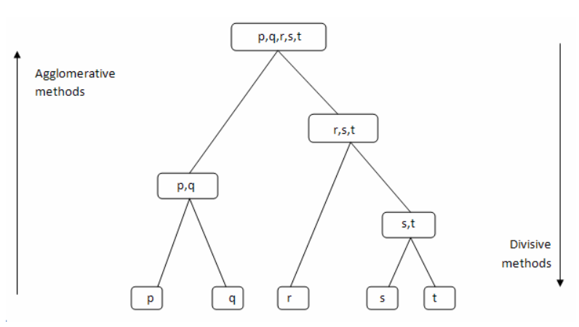
UNSUPERVISED LEARNING
There are two types of hierarchical clustering algorithms:
Agglomerative — Bottom up approach. Start with many small clusters and merge them together to create bigger clusters.
Divisive — Top down approach. Start with a single cluster than break it up into smaller clusters.
Notes:
Some notes and images were retrieved from slayts of Yücel Saygin and article of Cory Maklin

Slide 19
UNSUPERVISED LEARNING
Pros
No assumption of a particular number of clusters (i.e. k-means)
May correspond to meaningful taxonomies
Cons
Once a decision is made to combine two clusters, it can’t be undone
Too slow for large data sets, O(𝑛2 log(𝑛))
Notes:
Some notes and images were retrieved from slayts of Yücel Saygin and article of Cory Maklin

Slide 20
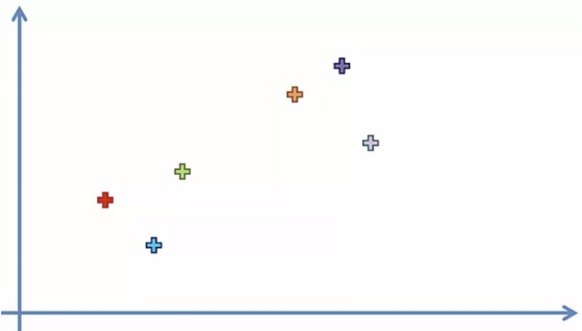
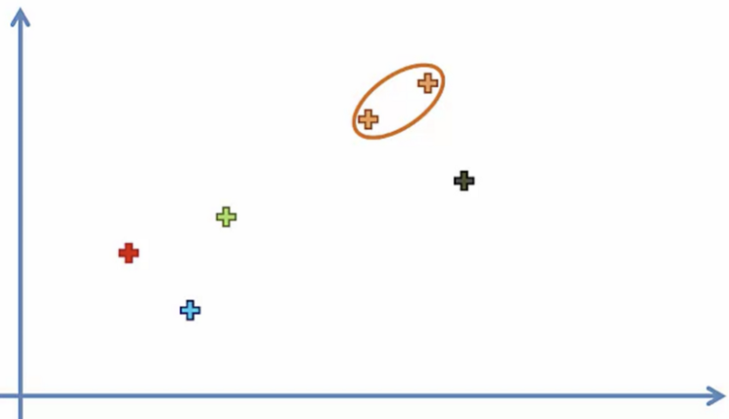
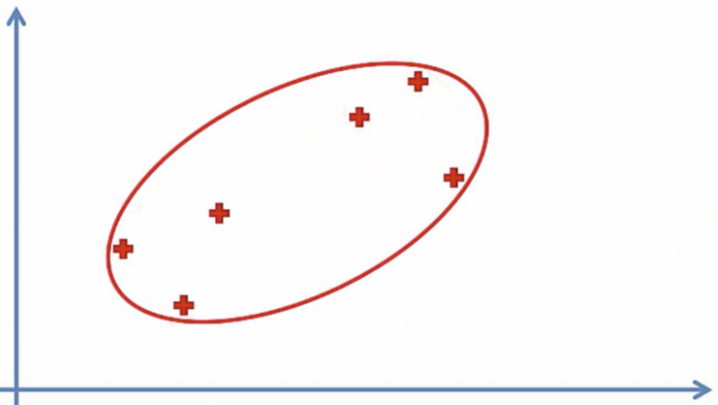
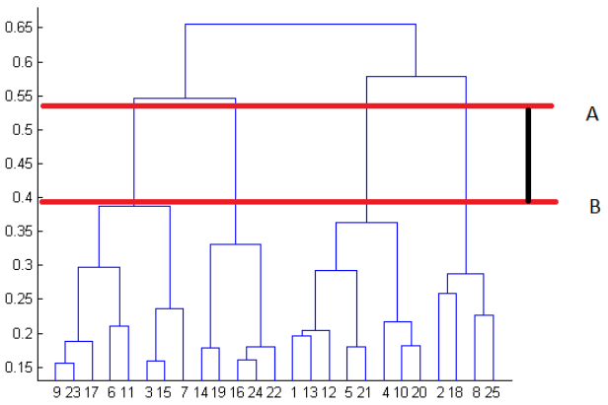
UNSUPERVISED LEARNING
How it works?
Make each data point a cluster
2. Take the two closest clusters and make them one cluster
3. Repeat step 2 until there is only one cluster
Dendrograms
Used to visualize the history of groupings and figure out the optimal number of clusters.
Determine the largest vertical distance that doesn’t intersect any of the other clusters.
Draw a horizontal line at both extremities.
The optimal number of clusters is equal to the number of vertical lines going through the horizontal line.
For e.g, in figure on the right, best choice for no. of clusters will be 4.
Notes:
Some notes and images were retrieved from slayts of Yücel Saygin and article of Cory Maklin

Slide 21
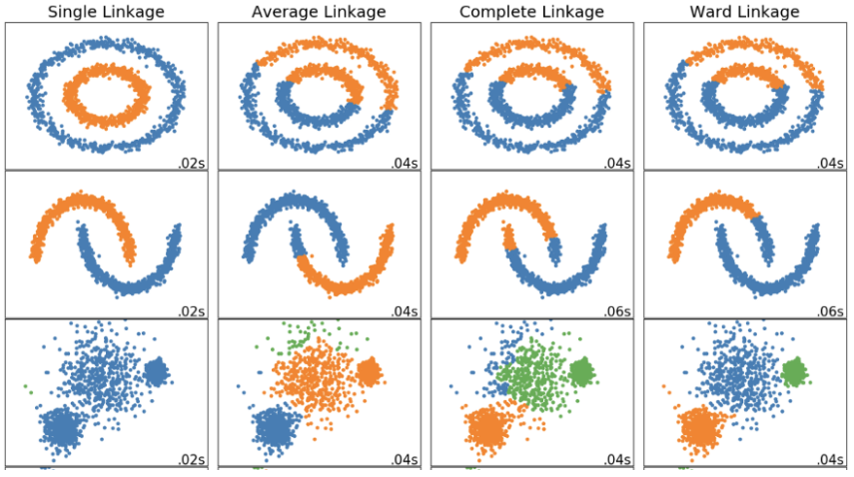
UNSUPERVISED LEARNING
Linkage Criteria
The linkage criteria refers to how the distance between clusters is calculated.
Similar to gradient descent, you can tweak certain parameters to get drastically different results.
Notes:
Some notes and images were retrieved from slayts of Yücel Saygin and article of Cory Maklin

Slide 22
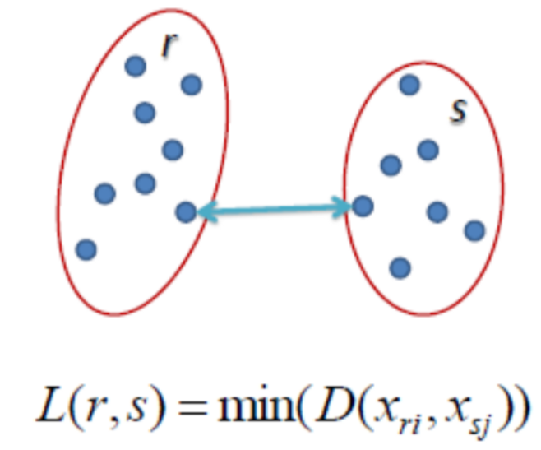
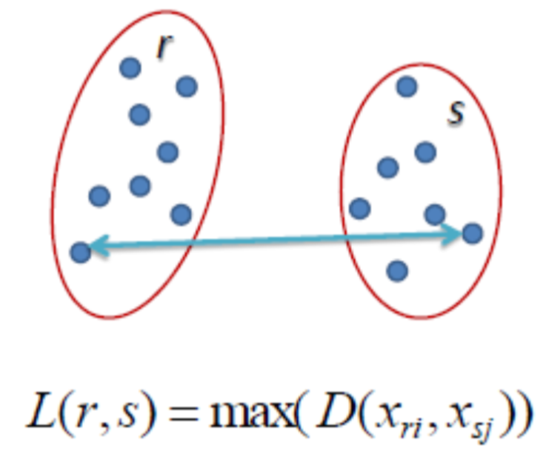
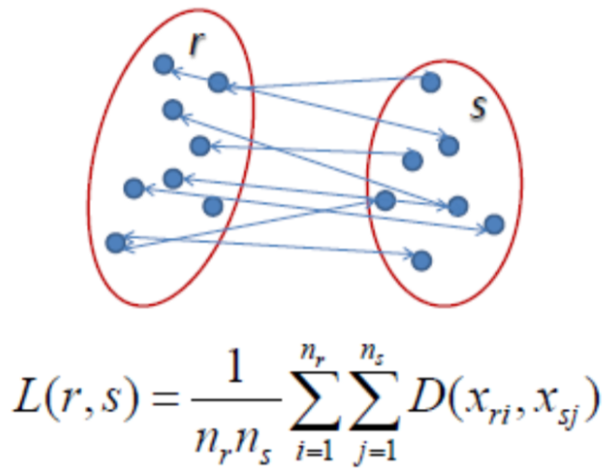
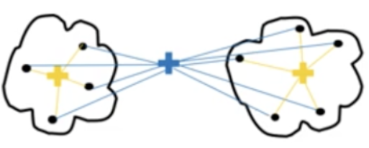
UNSUPERVISED LEARNING
Single Linkage
The distance between two clusters is the shortest distance between two points in each cluster.
Complete Linkage
The distance between two clusters is the longest distance between two points in each cluster
Average Linkage
The distance between clusters is the average distance between each point in one cluster to every point in other cluster
Ward Linkage
The distance between clusters is the sum of squared differences within all clusters
Notes:
Some notes and images were retrieved from slayts of Yücel Saygin and article of Cory Maklin

Slide 23
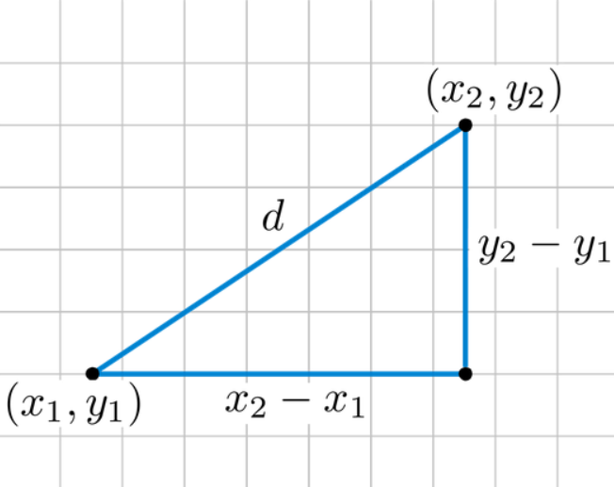
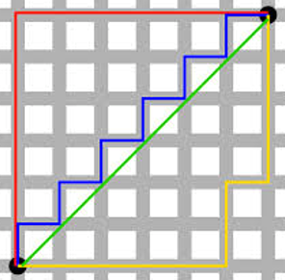
UNSUPERVISED LEARNING
Distance Metric
The method you use to calculate the distance between data points will affect the end result.
Euclidean Distance
The shortest distance between two points.
For example, if v1=(x1,y1) and v2=(x2,y2), the Euclidean distance between v1 and v2 is √(x1−x2)²+(y1−y2)²
Manhattan Distance
y
Imagine you were in the downtown center of a big city and you wanted to get from point A to point B. You wouldn’t be able to cut across buildings, rather you’d have to make your way by walking along the various streets. For example, if x=(a,b) and y=(c,d), the Manhattan distance between x and y is |a−c|+|b−d|
x
Notes:
Some notes and images were retrieved from slayts of Yücel Saygin and article of Cory Maklin

Slide 24
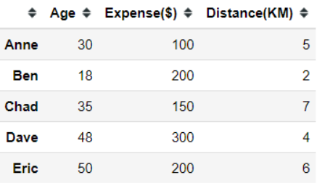
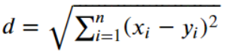
UNSUPERVISED LEARNING
Example
Let’s say we have 5 different people with 3 different continuous features and we want to see how we could cluster these people.
First thing first, we need to decide our clustering distance measurement.
Let’s use Euclidean Distance
Notes:
Some notes and images were retrieved from slayts of Yücel Saygin and article of Cory Maklin

Slide 25


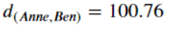
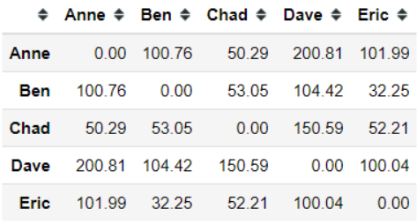
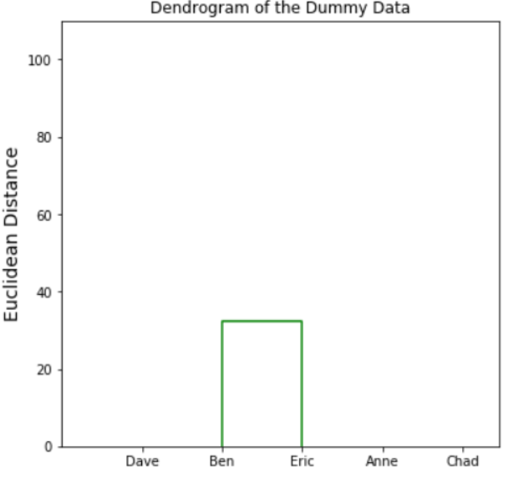
UNSUPERVISED LEARNING
In the dummy data, we have 3 features (or dimensions) representing 3 different continuous features. In this case, we could calculate the Euclidean distance between Anne and Ben using the formula below.
Similarly, applying the measurement to all the data points should result in the following distance matrix
After that, we merge the smallest non-zero distance in the matrix to create our first node. In this case, it is Ben and Eric.
Notes:
Some notes and images were retrieved from slayts of Yücel Saygin and article of Cory Maklin

Slide 26
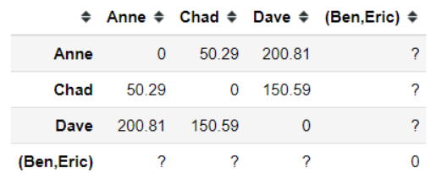
UNSUPERVISED LEARNING
With a new node or cluster, we need to update our distance matrix.
Now we have a new cluster of Ben and Eric, but we still did not know the distance between (Ben, Eric) cluster to the other data point. How do we even calculate the new cluster distance? In order to do this, we need to set up the linkage criterion first.
Remember! The linkage criterion is where exactly the distance is measured. It is a rule that we establish to define the distance between clusters.
We'll use Single Linkage.
Notes:
Some notes and images were retrieved from slayts of Yücel Saygin and article of Cory Maklin

Slide 27
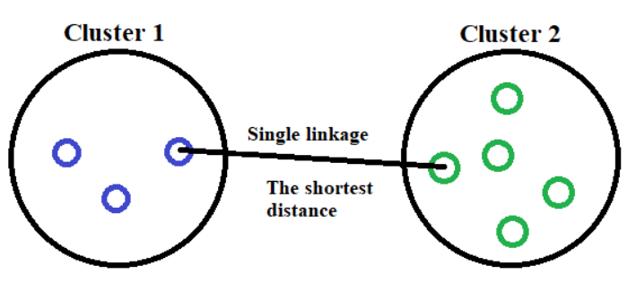
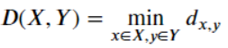
UNSUPERVISED LEARNING
In a single linkage criterion we, define our distance as the minimum distance between clusters data point. If we put it in a mathematical formula, it would look like this.
If we apply the single linkage criterion to our dummy data, say between Anne and cluster (Ben, Eric) it would be described as the picture below.
Notes:
Some notes and images were retrieved from slayts of Yücel Saygin and article of Cory Maklin

Slide 28
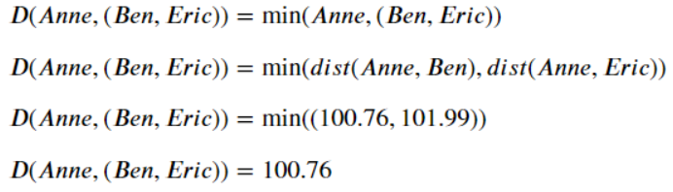
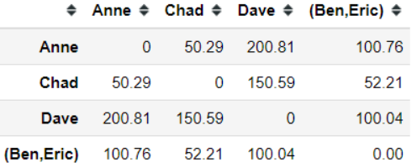
UNSUPERVISED LEARNING
Now, we have the distance between our new cluster to the other data point. Although if you notice, the distance between Anne and Chad is now the smallest one. In this case, the next merger event would be between Anne and Chad.
Notes:
Some notes and images were retrieved from slayts of Yücel Saygin and article of Cory Maklin

Slide 29
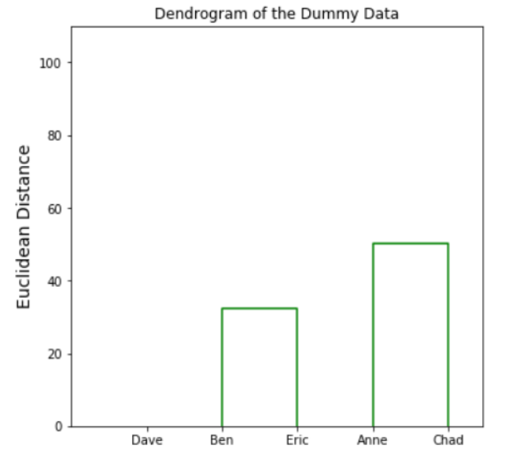
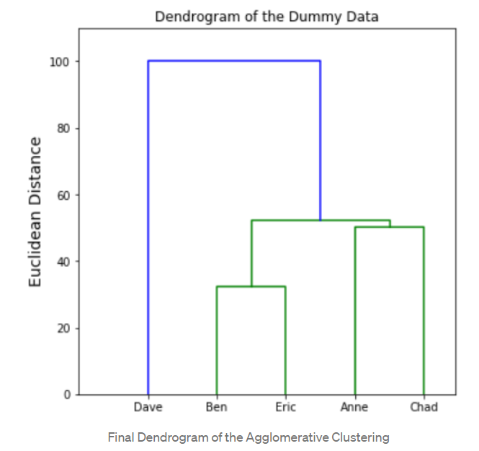
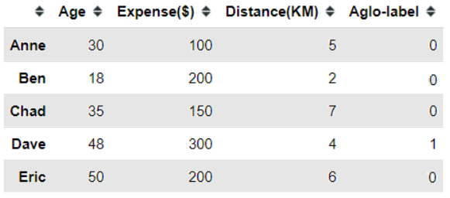
UNSUPERVISED LEARNING
We keep the merging event happens until all the data is clustered into one cluster. In the end, we would obtain a dendrogram with all the data that have been merged into one cluster.
The highest vertical distance that doesn’t intersect with any clusters that cross the threshold gives us the number of clusters.
Notes:
Some notes and images were retrieved from slayts of Yücel Saygin and article of Cory Maklin

Slide 30
UNSUPERVISED LEARNING
The Agglomerative Clustering w/ Python
from sklearn.cluster import AgglomerativeClustering
aglo = AgglomerativeClustering(n_clusters=2, affinity='euclidean', linkage='single')
aglo.fit_predict(dummy)
dummy['Aglo-label'] = aglo.fit_predict(dummy)
Notes:
Some notes and images were retrieved from slayts of Yücel Saygin and article of Cory Maklin

Slide 31
Density Based Algorithms
Notes:
Some notes and images were retrieved from slayts of Yücel Saygin and article of Cory Maklin

Slide 32
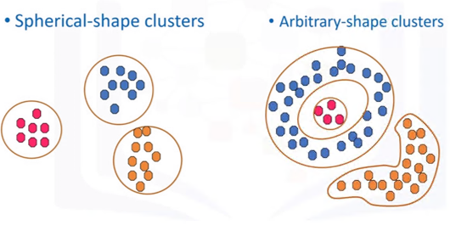
UNSUPERVISED LEARNING
DBSCAN
Centroid based algorithms cannot detect clusters which are not gathered regarding distance
Notes:
Some notes and images were retrieved from slayts of Yücel Saygin and article of Cory Maklin

Slide 33
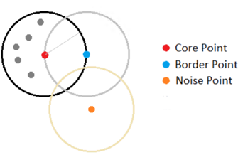
UNSUPERVISED LEARNING
Data points close to each other are accepted as a group for density based algorithms
Notes:
Some notes and images were retrieved from slayts of Yücel Saygin and article of Cory Maklin

Slide 34
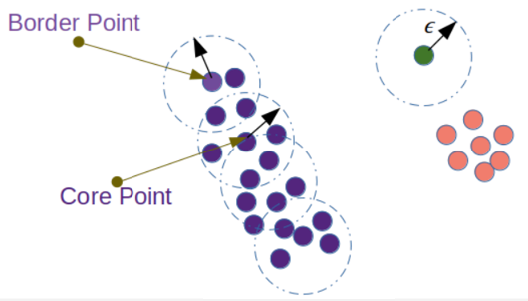
UNSUPERVISED LEARNING
In an epsilon distance, the algorithm checks number of points that are near a point
If the number of neighbor data points are above a threshold (manually given) that point is accepted as a core point
Border points are close to core points, however they do not have enough neighbors
Core points and border points form a cluster together
The points which can not form a core point alone or close to a core point are accepted as noise
Notes:
Some notes and images were retrieved from slayts of Yücel Saygin and article of Cory Maklin

Slide 35
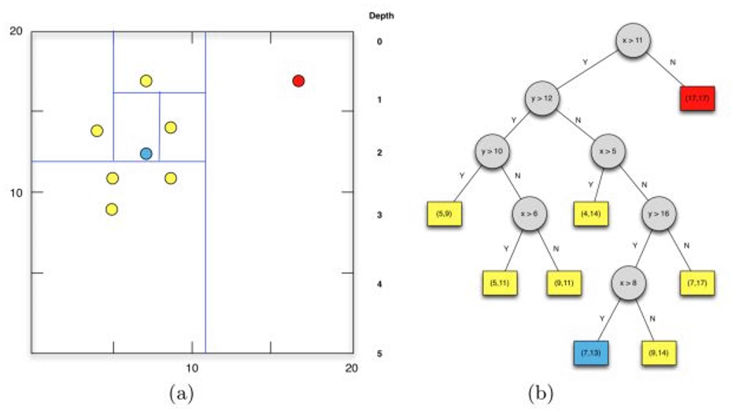
A bonus: Isolation Forest
Isolation forest is an unsupervised learning algorithm for anomaly detection that works on the principle of isolating anomalies, instead of the most common techniques of profiling normal points.
Notes:
Some notes and images were retrieved from slayts of Yücel Saygin and article of Cory Maklin

